Slide 1
Steganography Project
By Miles Kuhn, David Helgeson, and George Popov

Slide 2
Paper Highlights 1: Background Information
Our tool is a type of steganography
Steganography is the art of concealing information within non-secret data to avoid detection
The idea of steganography is to make the existence of the message inconspicuous
Because users are allowed to exchange these encoded messages, it is not considered a covert channel
Can be used on to encode any type of information (as bytes)
Simple steganography like in this project can be detected easily with statistical analysis
Notes:
David

Slide 3
Paper Highlights 2: How it Works
Our steganography tool hides messages within image files
It encrypts a message using AES encryption with an image hash as a key
First it computes a SHA-256 hash of the image file (encryption key)
Then it uses AES for the encryption and decryption of the message
The message is then encoded into the image
4 bits of information are coded into each pixel by encoding bit into RGBA value’s lsb
The first 8 pixels encode the length of the string
Decoding reverses process
Length of message is used to grab all the pixels up to the length
Pixels are read and turned into a bit string
Bit string is turned to bytes
Bytes are decrypted using the hash of the original image
Bytes are then written into a file
Notes:
Miles

Slide 4
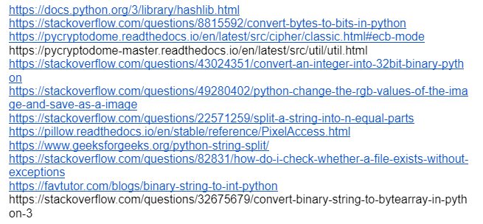
Paper Highlights 3: Tool Creation
Took lots of trial and error
Read documentation of python libraries and online forums
Encountered some trouble with the hashing
Limitations
data capacity of image
Weak encryption method
Notes:
Miles

Slide 5
Paper Highlights 4: Detection
Creates a new file in the system
The file should be visually the same
The image would likely pass as a copy of the original (ignoring the “ecoded_” part of the name)
Requires computer analysis
Upon inspection may find anomalies in the least significant bits of the encrypted file
First 32 bits store the length of encrypted message
Length is unencrypted and always has 16
Suspicious across multiple images
Notes:
David

Slide 6



Example (Observability)
Original Image
Encoded Image
Encoded Image with stronger effect
Notes:
David

Slide 7

Encoding and Decoding Demo
python Steganography.py -e image_file message
python Steganography.py -d image_file encoded_file output
Notes:
David

Slide 8
Demo!
Notes:
Miles

